Slide 1
Lívia Máté
1
liviamate8@gmail.com
2
Github: liviam8
3
Péter Pázmány Catholic University Faculty of Information Technology and Bionics
4
https://www.linkedin.com/in/livia-mate-797a69236

Slide 2
Silicon based deep brain electrode
1
2
3
4
Data collection
Data Processing
Electrophysiology Lab of the Péter Pázmány Catholic University
Electrode development
Deep Brain Stimulation
Institute of Technical Physics and Materials Science
Institute of Cognitive Neuroscience and Psychology
Real Life usage

Slide 3

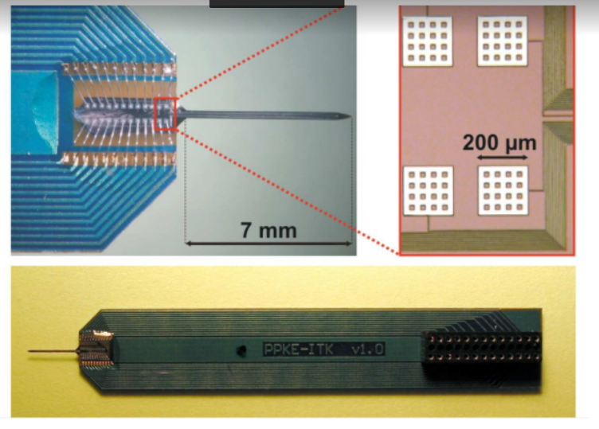
Electrode development
Notes:
During my work I was introduced to silicon based deep brain electrode technology, produced under Hungarian patents. This experience was used for exploring the possibility of a fabrication method of a deep-brain electrode. The shape of the electrode is formed with anisotropic wet chemical etching. The platinum layer, which forms the contacts is designed with lithography technology. My thesis contained the results of these processes

Slide 4
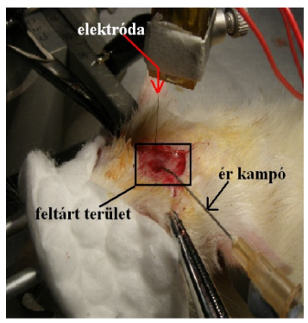

DATA Collection
Notes:
I analysed brain electric activity recorded from rat somatosensory cortex with multielectrodes.

Slide 5


Processing collected data
Notes:
Multiple mathematical methods were used for the computer analyses.

Slide 6
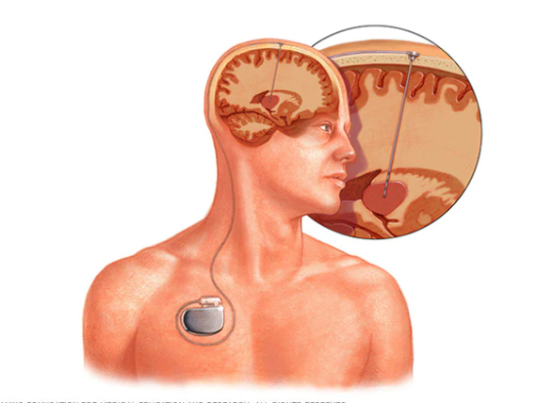

DBS real life usage
Notes:
Deep brain stimulation is a neurosurgical approach that involves use of brain- implanted electrodes. Primary used to treat movement disorders like Parkinson’s disease, but also used approved for use in treating epilepsy and OCD additionally has potential to treat other disorders as well like clinical depression.
Parkinson’s is a progressive neurological movement disorder that affects activities of daily living. Parkinson’s disease manifests as Tremor or Shaking OR lack of facial expression. Medications are effective, but over a period of time, the side effects of medications are more troublesome than the disease. Here comes the DBS as an excellent solution.
Deep brain stimulation is a treatment with keyhole procedure where two electrodes are implanted deep inside the brain. In case of Parkinson’s disease in the subthalamic nucleus, whose overactivity in the disease is thought to contribute to movement problems, like difficulty initiating movement. The small battery used to power the system is placed beneath the skin near the collar bone in a fashion similar to a pacemaker for the heart. Thin soft flexible wires connected the electrodes and the IPG. The IPG generates electrical impulses which are sent to affected parts of the brain via the implanted electrodes. These electrical impulses reset the distorted signals in the brain. This results in disappearance of reduction of symptoms in patients by almost 70 or 80% .
DBS is not a cure and does not help progression of the disease, but improving these symptoms can greatly improve the quality of life for those suffering from these illnesses.

Slide 7
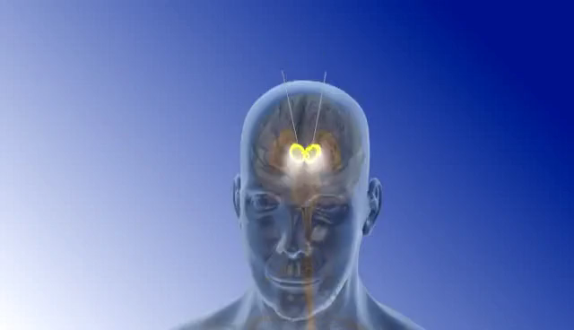
Deep brain stimulation

